Slide 1
ANGLEŠČINA ZA OTROKE
NADALJEVALNI TEČAJ

Slide 2
O AVTORICI
MARUŠA MALIGOJ, magistrica profesorica anglistike in ruščine
Dolgoletne izkušnje s poučevanjem individualnih in skupinskih tečajev angleškega jezika
Eramus+ praksa na osnovni šoli Dore Primary School v Sheffieldu, VB

Slide 3
PROGRAM
6 srečanj po 60 min
Termini četrtek, 21. 5., 16.30-17.30 petek, 22. 5., 16.30-17.30 ponedeljek, 25. 5., 16.30-17.30 torek, 26. 5, 16.30-17.30 sreda, 27. 5., 16.30-17.30 četrtek, 28. 5., 16.30-17.30

Slide 4
KAJ SE BOMO NAUČILI?
HOW ARE YOU?: čustva in počutje
IT’S SUNNY!: vreme, temperatura, števila
IN MY FREE TIME: hobiji, glasbila, šport
I HAVE GREEN EYES: deli telesa, izgled
WHAT IS SHE LIKE?: osebnost
MY MUM IS A TEACHER: poklici

Slide 5
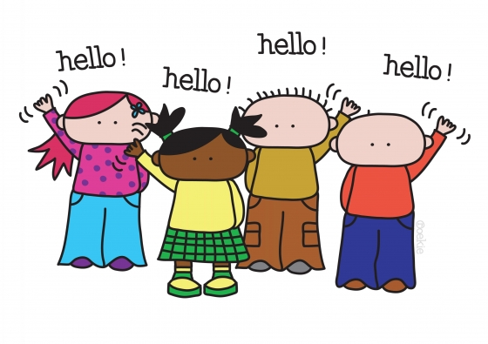
HELLO
HI
HELLO
GOOD MORNING
GOOD AFTERNOON
GOOD EVENING

Slide 6
YOUR MOOD
HOW ARE YOU?
HOW ARE YOU FEELING TODAY?
HOW DO YOU FEEL?

Slide 7
HI, HOW ARE YOU?
I’M …
SO-SO
OKAY
NOT SO GOOD
GOOD
WELL
NOT SO WELL
GREAT
NOT THAT GREAT
HAPPY
SAD
EXCITED

Slide 8
HOW ARE YOU?
Hi, Judy, how are you?
Hey, Jack. I’m good. And you?
Not that great.

Slide 9
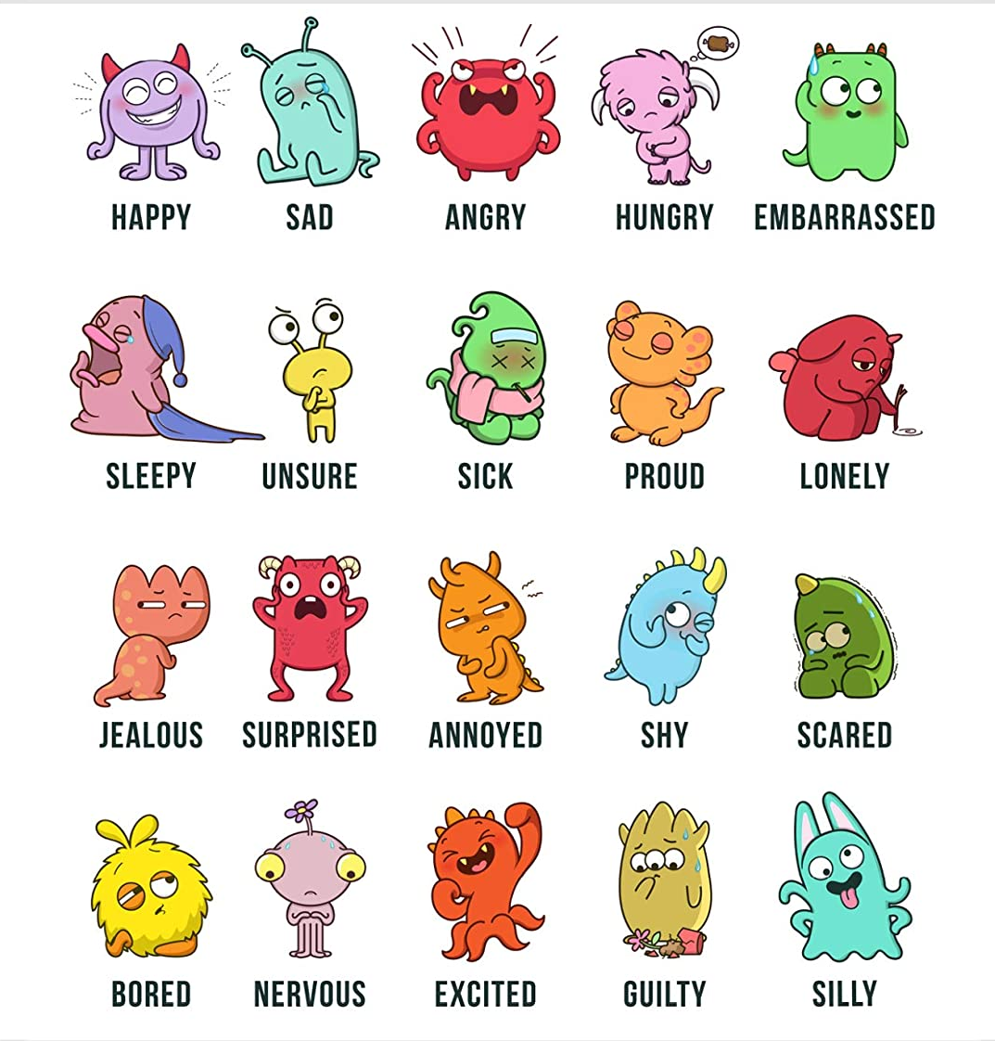
FEELINGS & EMOTIONS
POSITIVE
NEUTRAL
Happy
Proud
Excited
Silly
Hungry
Embarrassed
Sleepy
Unsure
Sick
Jealous
Surprised
Shy
Bored
Nervous
Guilty
NEGATIVE
Sad
Angry
Lonely
Annoyed
Scared

Slide 10
FEELINGS & EMOTIONS
HOW IS SHE FEELING?
SHE IS (FEELING) …
HAPPY
SAD
EXCITED
ANGRY

Slide 11
FEELINGS & EMOTIONS
HOW IS SHE FEELING?
HE IS (FEELING) …
SILLY
SURPRISED
UNSURE
BORED

Slide 12
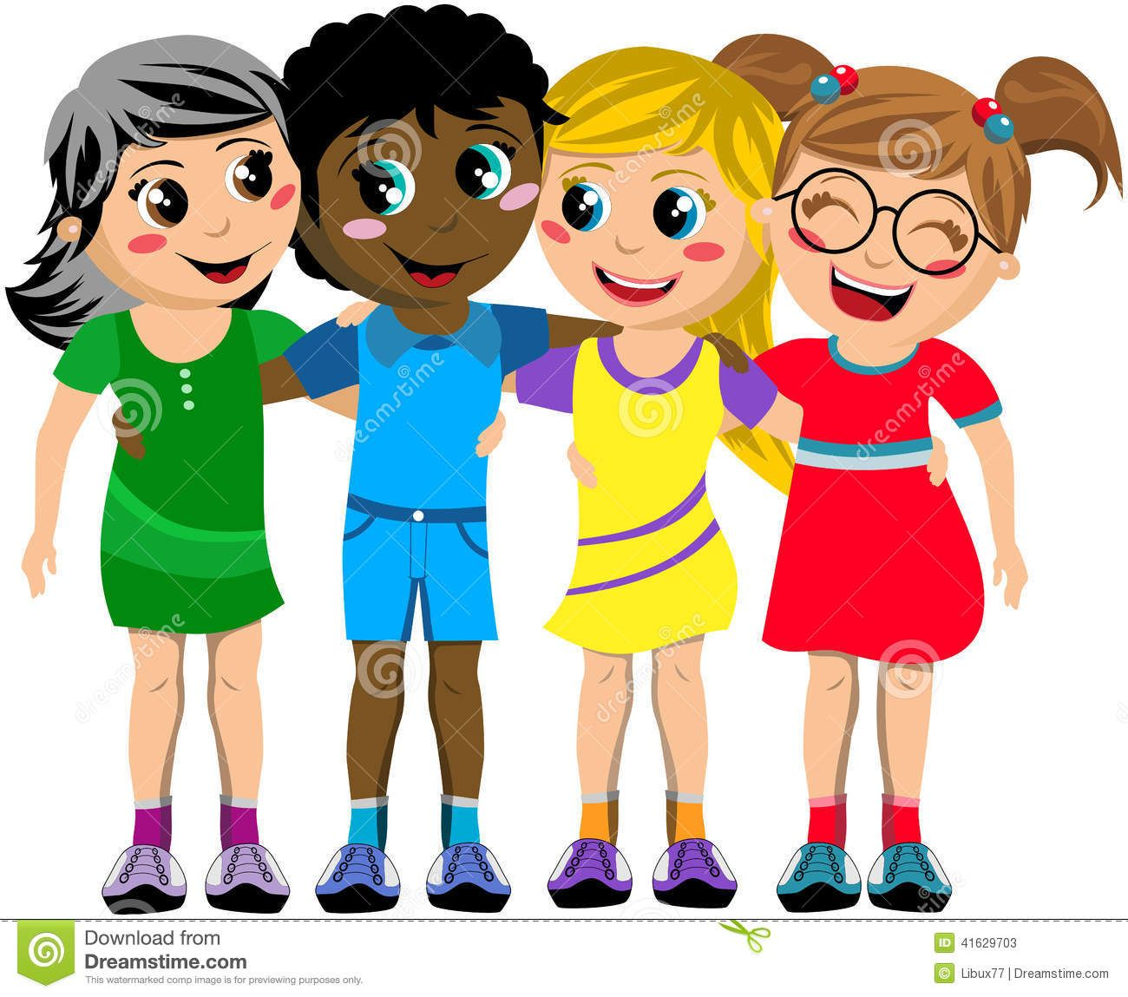
FEELINGS & EMOTIONS
HOW ARE THEY FEELING?
THEY ARE (FEELING) …
HAPPY

Slide 13
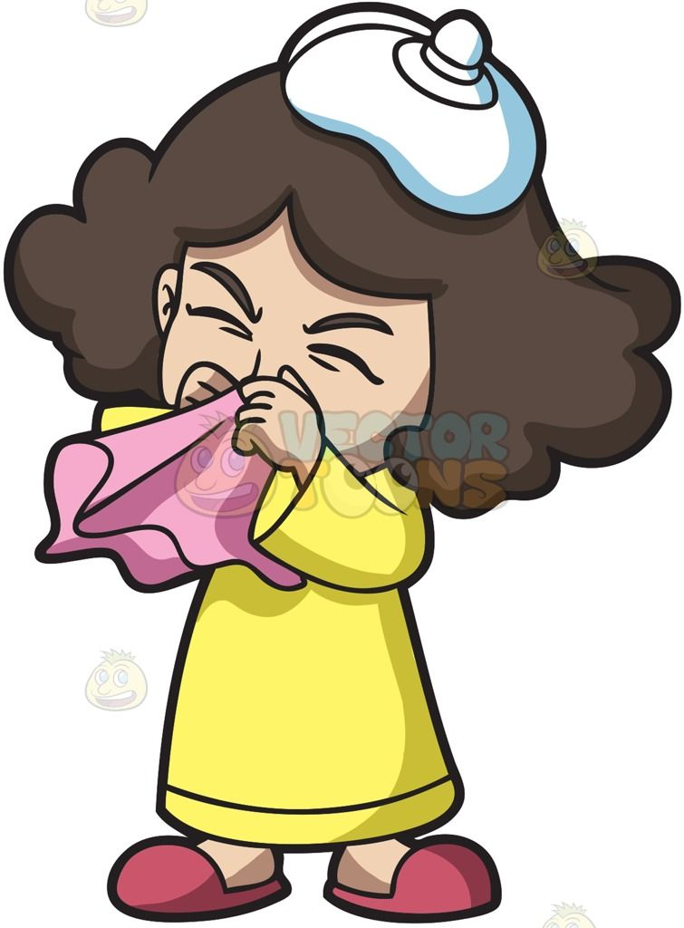
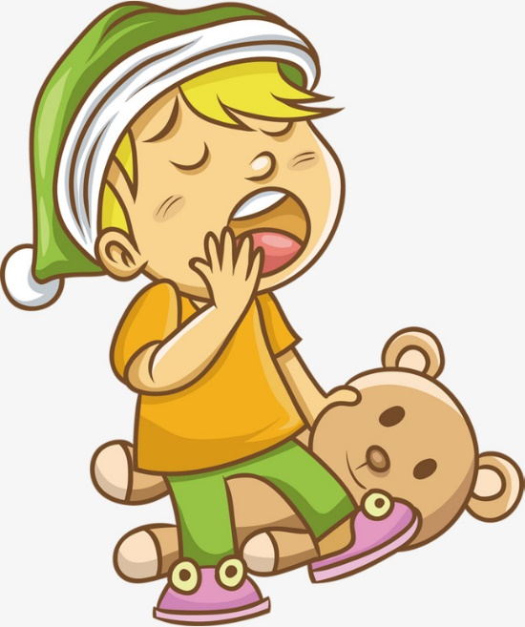
FEELINGS & EMOTIONS
Is Billy bored?
Is Susie sick?
No, Billy is sleepy.
Yes, Susie is sick.

Slide 14
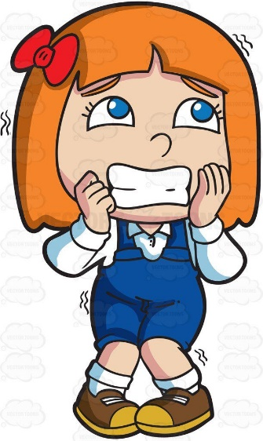
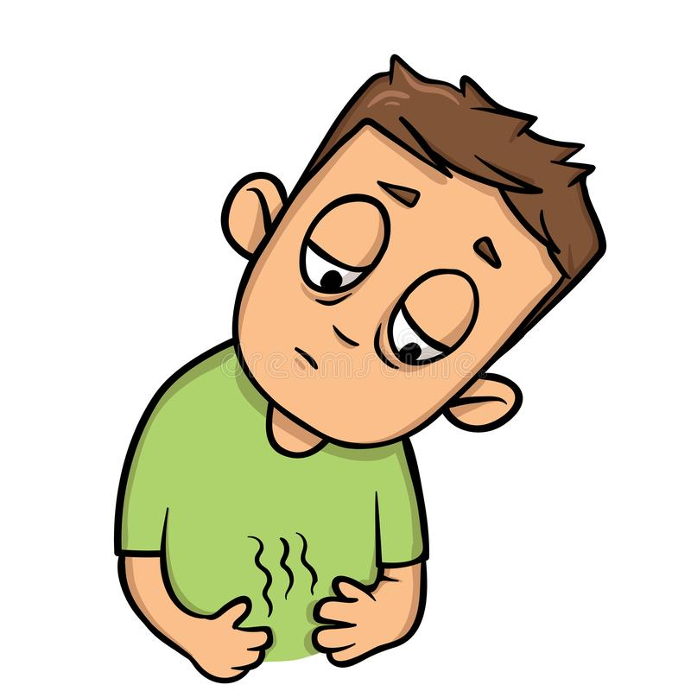
FEELINGS & EMOTIONS
Is Katie annoyed?
Is Bobby hungry?
No, Katie is nervous.
Yes, Bobby is hungry.

Slide 15
ARE YOU …?
Hey, Ross, are you ok? You look sad.
No, I’m just sleepy.
I’m a bit tired too.

Slide 16
WEATHER
SPRING
SUMMER
FALL
WINTER
AUTUMN

Slide 17
WEATHER
WHAT IS THE WEATHER LIKE?

Slide 18
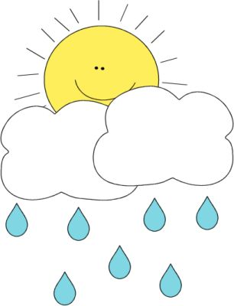
WHAT IS THE WEATHER LIKE …
IN SPRING?
IT IS …
SUNNY
CLOUDY
WARM
CHILLY
RAINY

Slide 19
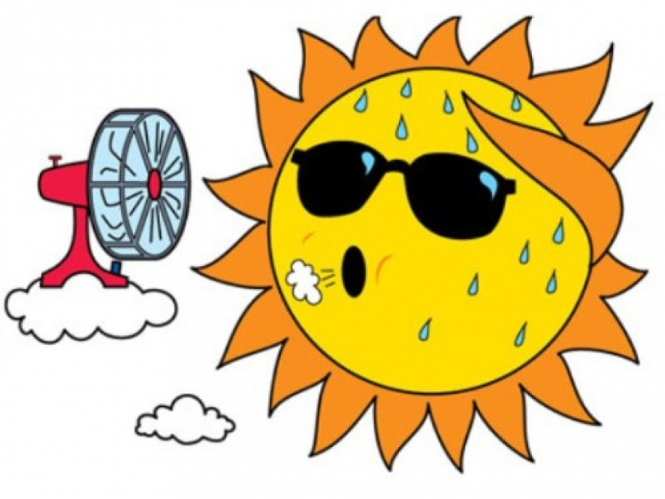
WHAT IS THE WEATHER LIKE …
IN SUMMER?
IT IS …
SUNNY
WARM
WARM
CLOUDY
RAINY

Slide 20
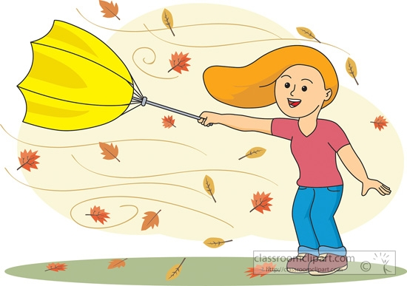
WHAT IS THE WEATHER LIKE …
IN AUTUMN/FALL?
IT IS …
CHILLY
SUNNY
WINDY
WARM
CLOUDY
PLEASANT
RAINY
FOGGY
STORMY

Slide 21
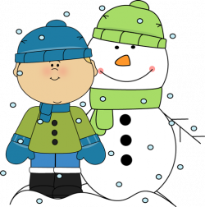
WHAT IS THE WEATHER LIKE …
IN WINTER?
IT IS …
COLD
CHILLY
SNOWY
FOGGY
FREEZING
SUNNY
CLOUDY

Slide 22
WEATHER
SUN
CLOUD
WIND
RAIN
THUNDERSTORM
SNOW

Slide 23
HOW IS THE WEATHER TODAY?
IS IT ..
RAINY?
CLOUDY?
SUNNY?
NO, IT’S NOT.
NO, IT’S NOT.
YES, IT IS!

Slide 24
NUMBERS
ONE
TWO
THREE
FOUR
FIVE
SIX
SEVEN
EIGHT
NINE
TEN

Slide 25
NUMBERS
TEN
ELEVEN
TWELVE
THIRTEEN
FOURTEEN
FIFTEEN
SIXTEEN
SEVENTEEN
EIGHTEEN
NINETEEN
TWENTY

Slide 26
NUMBERS
NINETY
EIGHTY
SEVENTY
SIXTY
HUNDRED
FIFTY
TEN
TWENTY
THIRTY
FORTY

Slide 27
TEMPERATURE
WHAT IS THE TEMPERATURE OUTSIDE?
WHAT IS THE TEMPERATURE TODAY?

Slide 28
WHAT’S THE TEMPERATURE OUTSIDE?
23
0
twenty-three
zero
36
-10
thirty-six
minus ten
-27
42
minus twenty-seven
forty-two

Slide 29
CAN YOU TELL THE TEMPERATURE?
-11
25
34
42
minus eleven
thirty-four
twenty-five
forty-two

Slide 30
HOBBIES
WHAT DO YOU DO IN YOUR FREE TIME?
WHAT DO YOU LIKE TO DO IN YOUR FREE TIME?

Slide 31
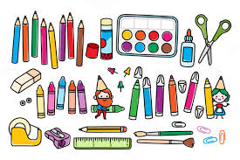
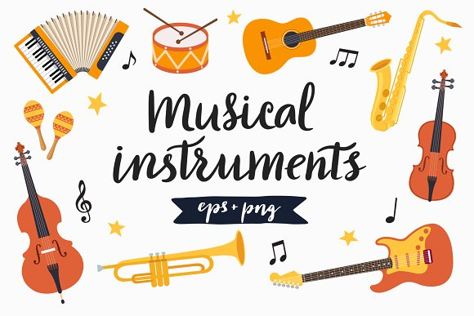
HOBBIES
IN MY FREE TIME I (LIKE TO) …
DO ARTS & CRAFTS
DO SPORTS
PLAY MUSICAL INSTRUMENTS

Slide 32
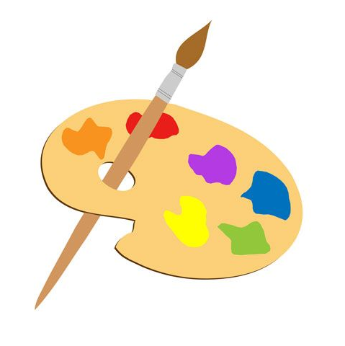
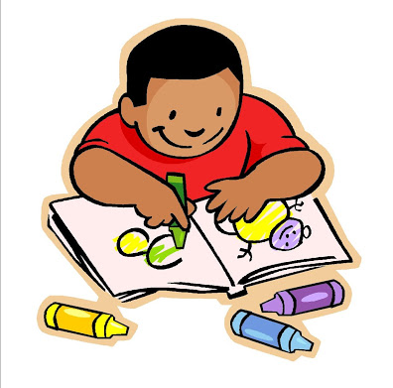
ARTS & CRAFTS
IN MY FREE TIME I LIKE TO
PAINT
DRAW
MAKE JEWELLERY
COLOUR COLOURING BOOKS

Slide 33
HOBBIES
IN MY FREE TIME I LIKE TO
READ BOOKS
PLAY VIDEO GAMES

Slide 34
HOBBIES
DO YOU LIKE TO …
READ BOOKS
PAINT
PLAY VIDEO GAMES

Slide 35
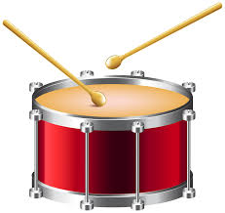
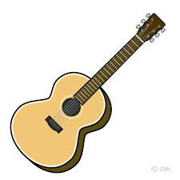
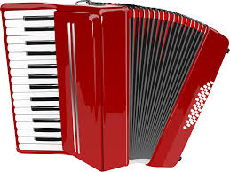
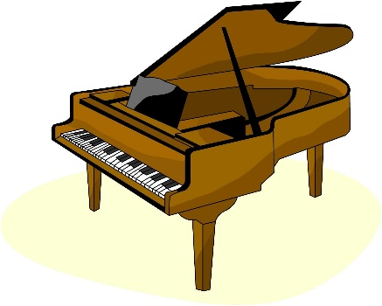
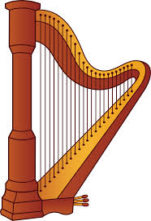
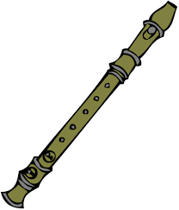
MUSICAL INStruMentS
IN MY FREE TIME I LIKE TO PLAY
THE VIOLIN
THE TRUMPET
DRUMS
THE GUITAR
THE ACCORDION
THE PIANO
THE HARP
THE FLUTE

Slide 36
MUSICAL INSTRUMENTS
DO YOU PLAY ANY INSTRUMENTS?
YES, I DO. I PLAY …
THE VIOLIN
THE ACCORDION
THE GUITAR

Slide 37
MUSICAL INSTRUMENTS
DO YOU PLAY ANY INSTRUMENTS?
NO, I DON’T (PLAY ANY INSTRUMENTS).

Slide 38
MUSICAL INSTRUMENTS
DO YOU KNOW HOW TO PLAY …
THE TRUMPET
THE PIANO
DRUMS
YES, I DO.
NO, I DON’T.

Slide 39
SPORTS
IN MY FREE TIME I LIKE TO PLAY
FOOTBALL SOCCER
BASKETBALL
VOLLEYBALL
TENNIS

Slide 40
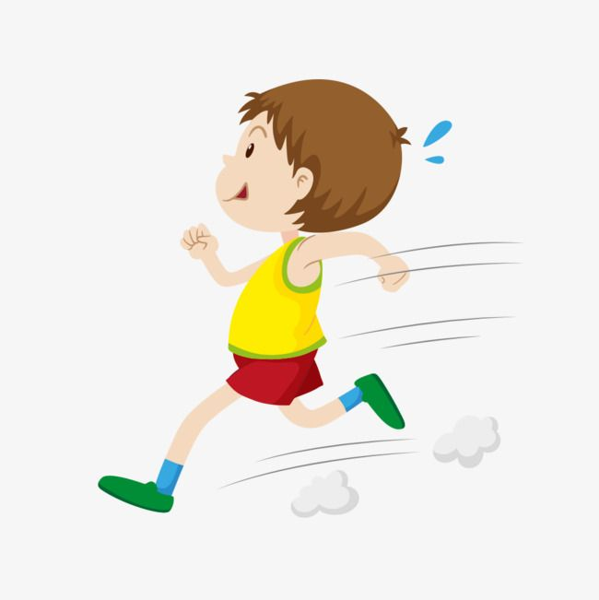
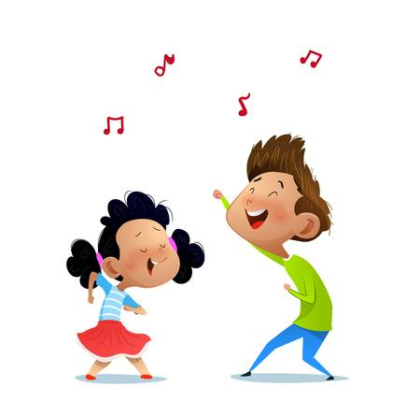
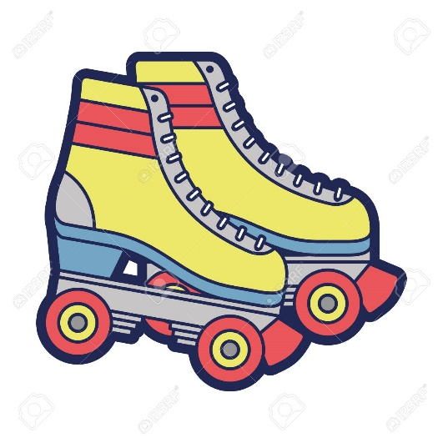
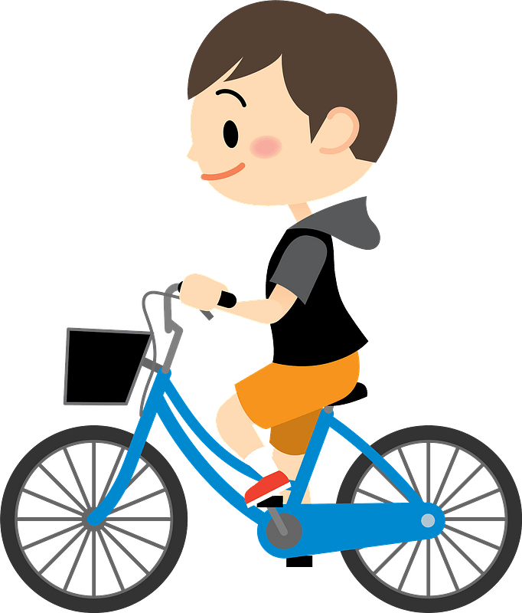
SPORTS
IN MY FREE TIME I LIKE TO
RUN
DANCE
ROLLER SKATE ROLLER BLADE
CYCLE

Slide 41
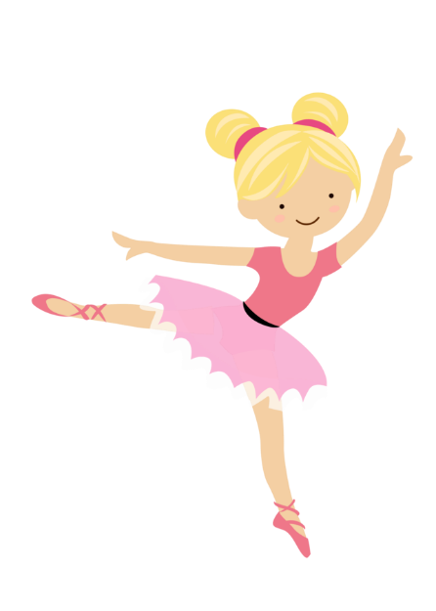
SPORTS
DO YOU DO ANY SPORTS?
YES, I DO. I …
PLAY VOLLEYBALL
RUN
PLAY TENNIS
DANCE BALLET
WHAT SPORT DO YOU DO?

Slide 42
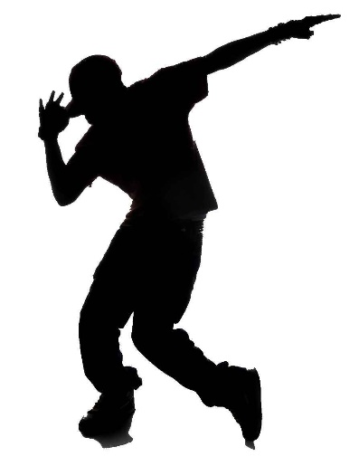
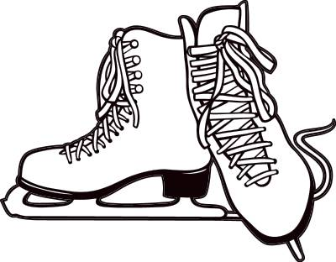
SPORTS
DO YOU KNOW HOW TO …
PLAY HOCKEY?
BREAKDANCE?
ICE SKATE?
DO A HANDSTAND?
YES, I DO.
NO, I DON’T.

Slide 43
SPORTS
DO YOU DO ANY SPORTS?
NO, I DON’T (DO ANY SPORTS).

Slide 44
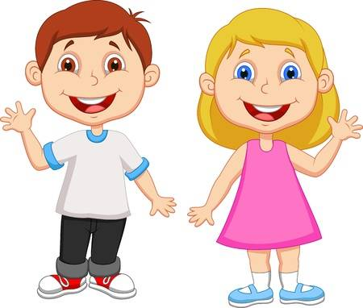
HOBBIES
WHAT DO THEY LIKE TO DO IN THEIR FREE TIME?
WHAT DOES CHRIS LIKE TO DO?
WHAT DOES NANCY LIKE TO DO?

Slide 45
HOBBIES
CHRIS LIKES TO …
NANCY LIKES TO …
PLAY VOLLEYBALL
DANCE BALLET
PAINT
PLAY THE GUITAR
PLAY THE ACCORDION
MAKE JEWELLERY

Slide 46
HOBBIES
DOES CHRIS LIKE TO …
DOES NANCY LIKE TO …
PLAY VOLLEYBALL?
DANCE BALLET?
YES, SHE DOES.
YES, HE DOES.
PLAY THE GUITAR?
PAINT?
NO, SHE DOESN’T.
NO, HE DOESN’T.

Slide 47
HOBBIES
WHAT DO THEY LIKE TO DO IN THEIR FREE TIME?
DO THEY LIKE TO ROLLER BLADE?
DO THEY LIKE TO PLAY VIDEO GAMES?
YES, THEY DO!
NO, THEY DON’T.

Slide 48
HOBBIES
WHAT DO YOU LIKE TO DO IN YOUR FREE TIME?
I LIKE TO ….

Slide 49
HOBBIES
DO YOU HAVE ANY HOBBIES?
YES, I DO. / NO, I DON’T.

Slide 50
HOBBIES
WHAT IS YOUR FAVOURITE INSTRUMENT?
WHAT IS YOUR FAVOURITE SPORT?

Slide 51
HOBBIES
DO YOU LIKE …
YES, I DO. / NO, I DON’T.

Slide 52
MY BODY
HEAD
HAIR
EYE/S
NOSE
EAR/S
MOUTH
PARTS OF THE BODY
SHOULDER/S
NECK
ARM(S)
CHEST
BACK
ELBOW
WRIST
STOMACH
HAND
FINGER
LEG
ANKLE
KNEE
FOOT/FEET

Slide 53
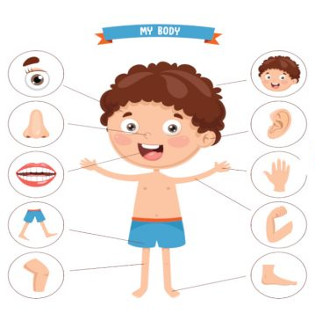
MY BODY
I HAVE …
TWO EYES
ONE HEAD
ONE NOSE
TWO EARS
ONE MOUTH
TWO HANDS
TWO LEGS
TWO ARMS
TWO KNEES
TWO FEET

Slide 54
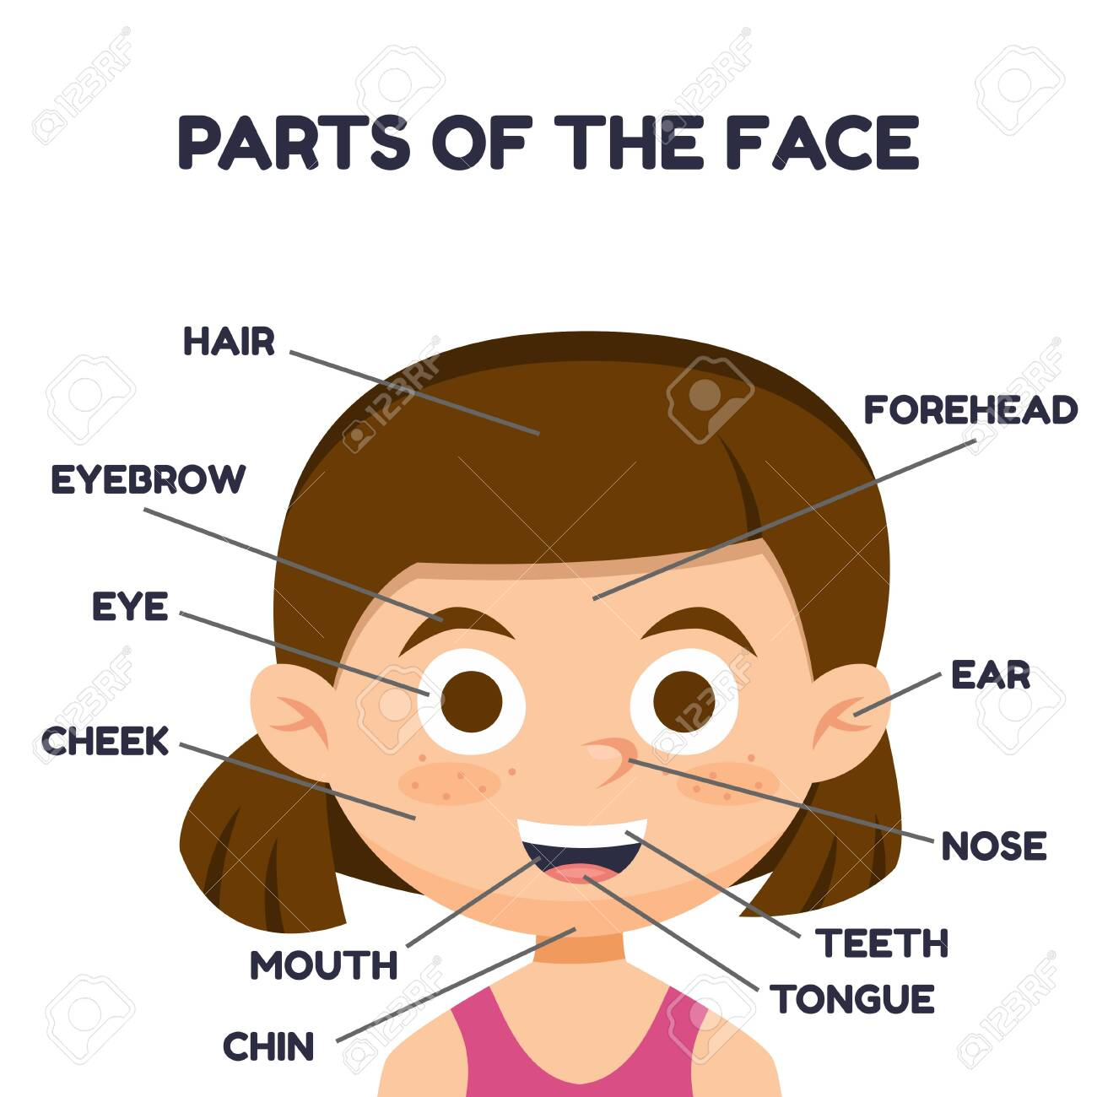
MY FACE
BIG
EARS
SMALL
MOUTH

Slide 55
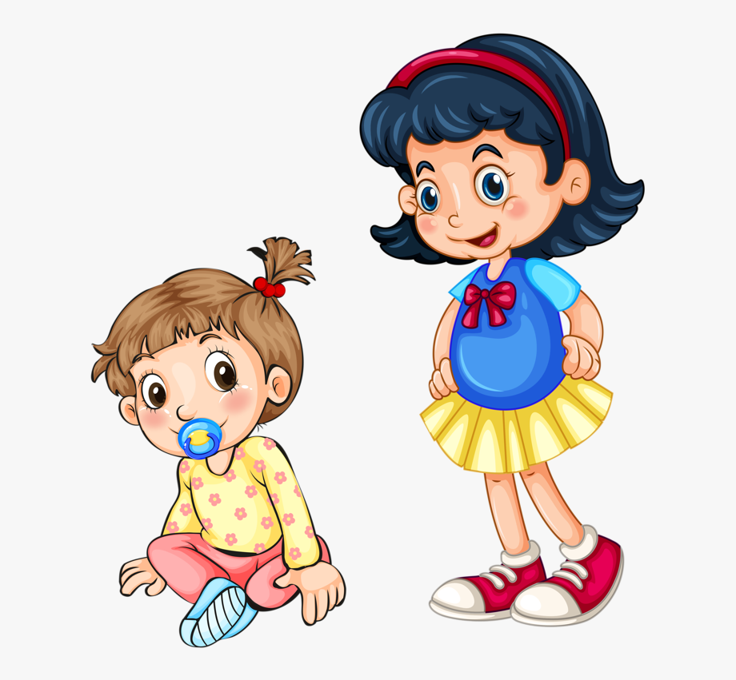
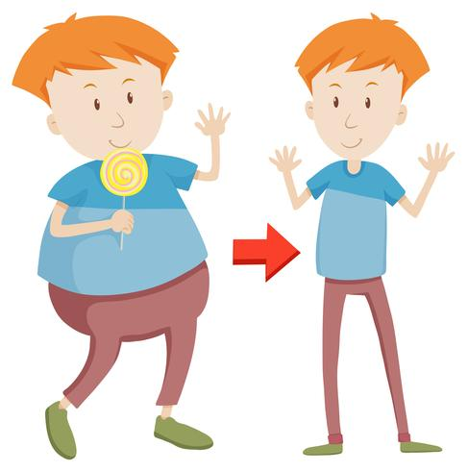
MY BODY
ARE YOU …
TALL
FAT
SHORT
SKINNY

Slide 56
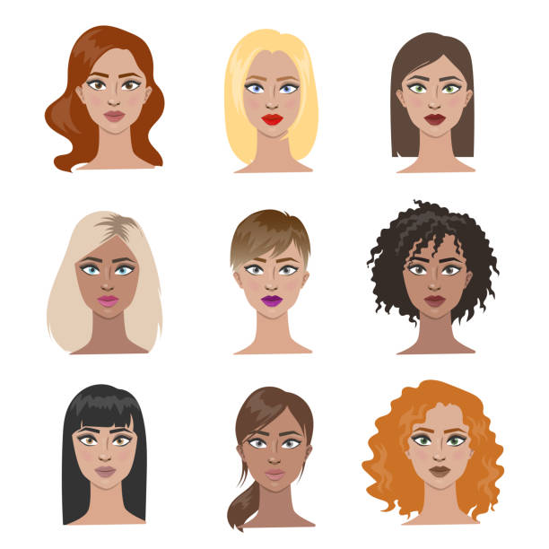
HAIR
WHAT KIND OF HAIR DO YOU HAVE?
IS YOUR HAIR …
SHORT
BROWN
STRAIGHT
BLOND
CURLY
BLACK
WAVY
LONG
RED/ GINGER

Slide 57
HAIR
WHAT KIND OF HAIR DOES SHE HAVE?
HER HAIR IS …
LONG
LONG
STRAIGHT
CURLY
BROWN
RED/ GINGER

Slide 58
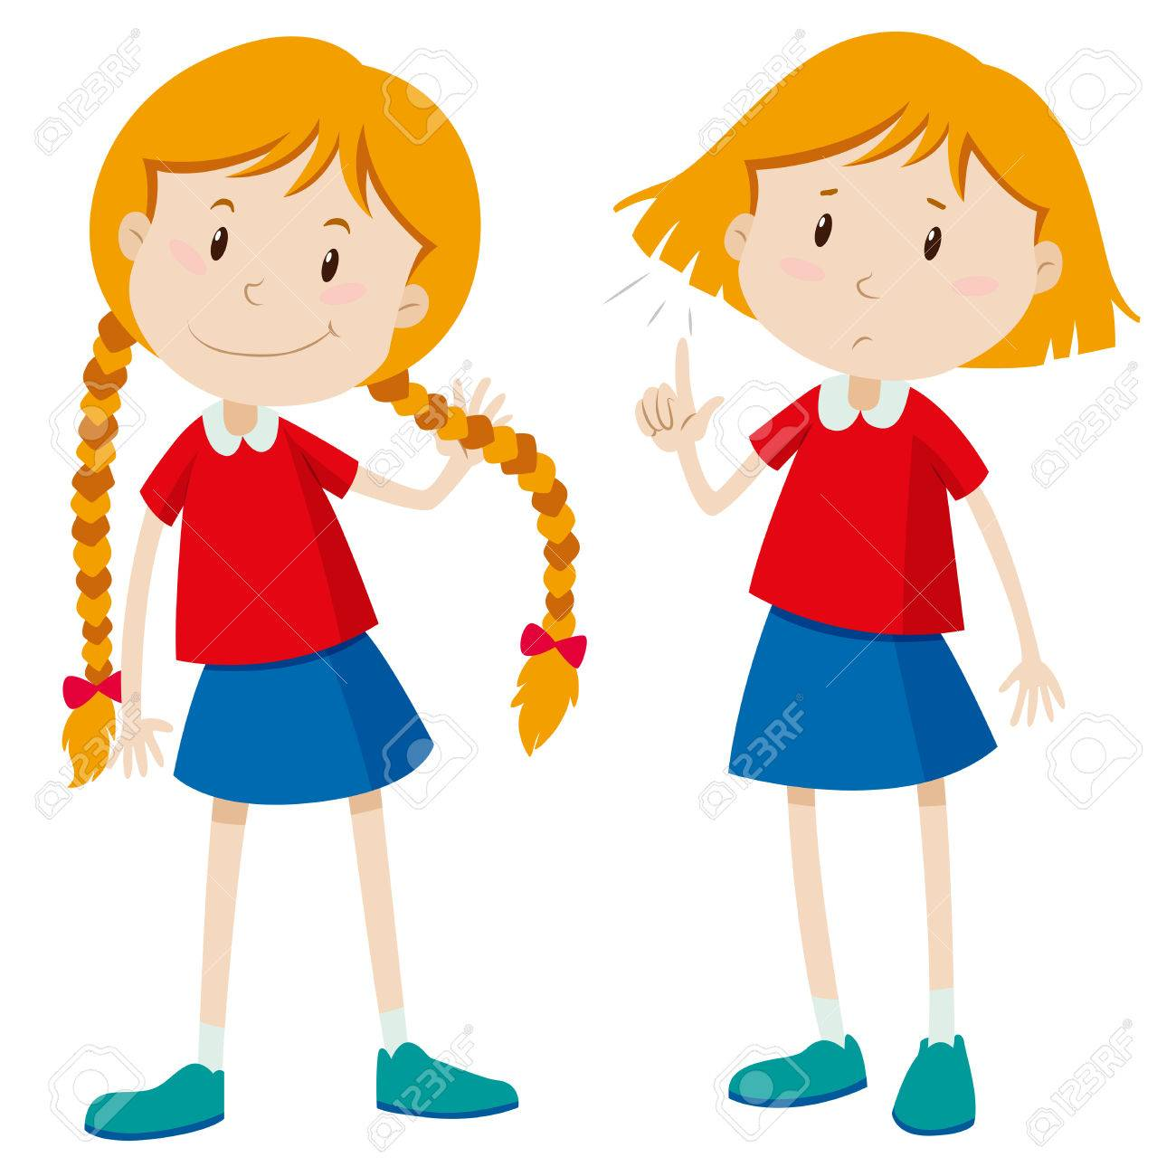
HAIR
WHAT KIND OF HAIR DOES SHE HAVE?
IS HER HAIR …
CURLY?
SHORT?
NO, IT ISN’T.
YES, IT IS.
BROWN?
STRAIGHT?
NO, IT ISN’T.
YES, IT IS.

Slide 59
HAIR
WHAT KIND OF HAIR DO YOU HAVE?
WHAT DOES YOUR HAIR LOOK LIKE?
WHAT IS THE COLOUR OF YOUR HAIR?

Slide 60
EYES
WHAT COLOUR ARE YOUR EYES?
ARE YOUR EYES …
BROWN?
BLUE?
GREEN?
GREY?

Slide 61
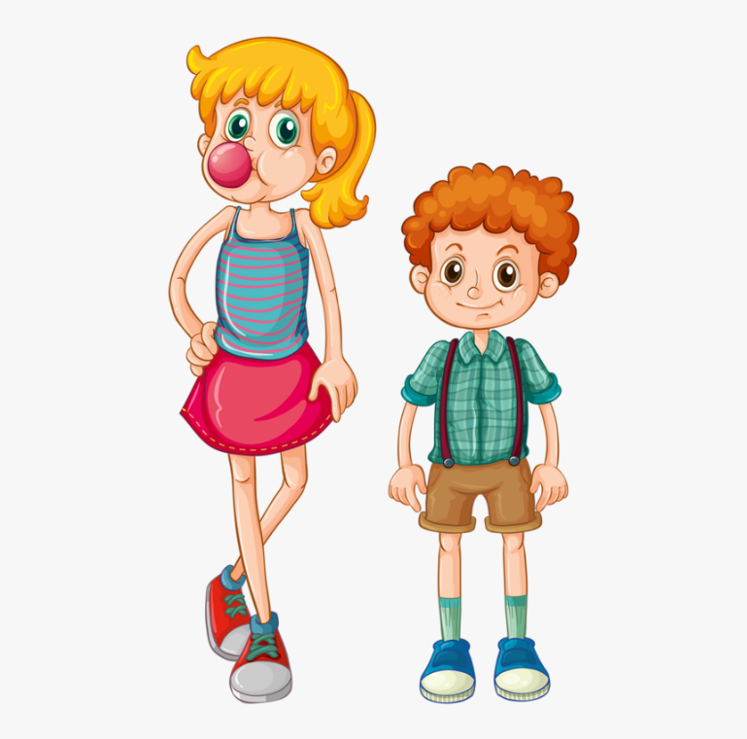
APPEARANCE
WHAT DO THEY LOOK LIKE?
WHAT DOES SHE
LOOK LIKE?
WHAT DOES HE
LOOK LIKE?

Slide 62
APPEARANCE
WHAT DOES SHE
LOOK LIKE?
WHAT DOES HE
LOOK LIKE?
She is tall and skinny.
He is short and skinny.
She has long, straight
blond hair and green eyes.
He has short, curly ginger hair.

Slide 63
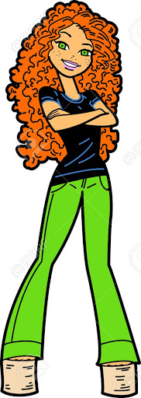
APPEARANCE
WHAT DOES SHE LOOK LIKE?
She is TALL.
She is SKINNY.
She has LONG, CURLY, GINGER HAIR.
She has BRIGHT GREEN EYES.

Slide 64
APPEARANCE
WHAT DOES HE LOOK LIKE?
He has TWO ears.
He has ONE eye.
He has FOUR arms.
He is short, fat, and blue.
And TWO legs.

Slide 65
APPEARANCE
WHAT DO YOU LOOK LIKE?
WHAT DOES YOUR HAIR LOOK LIKE?
WHAT IS THE COLOUR OF YOUR EYES?
ARE YOU: TALL/SHORT, FAT/SKINNY …
DO YOU WEAR GLASSES?

Slide 66
GUESS WHO
Jess
Fiona
Monica
Tara
Lisa
Cindy

Slide 67
CHARACTER

Slide 68
CHARACTER

Slide 69
CHARACTER
WHAT ARE YOU LIKE?

Slide 70
CHARACTER
WHAT IS CHRIS LIKE?
WHAT IS NANCY LIKE?
CREATIVE
LIVELY
KIND
FRIENDLY
GOOD- TEMPERED
HARD- WORKING

Slide 71
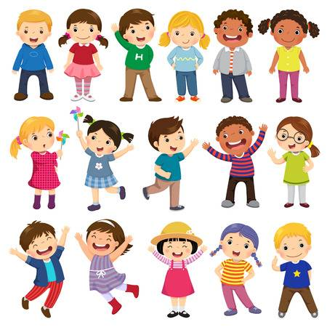
CHARACTER
WHAT ARE YOUR FRIENDS LIKE?
THEY ARE …

Slide 72
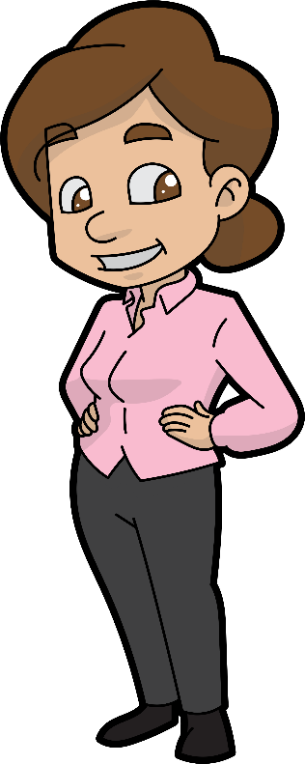
REVISION
This is Judy.
27
She is twenty-seven years old.
She is tall and skinny.
She has long, wavy brown hair and brown eyes.
In her free time, she likes to read books, run, and play the piano. She doesn’t like to play video games.
She is patient, talkative, and optimistic.

